Slide 1
United States Patent and Trademark Office (USPTO)

Slide 2
Intellectual Property and Social Media
Rebekah Oakes August 25, 2021

Slide 3

What is intellectual property (IP)?
Creations of the mind
A creative work that can be shared, such as an invention, design, or literary work

Slide 4
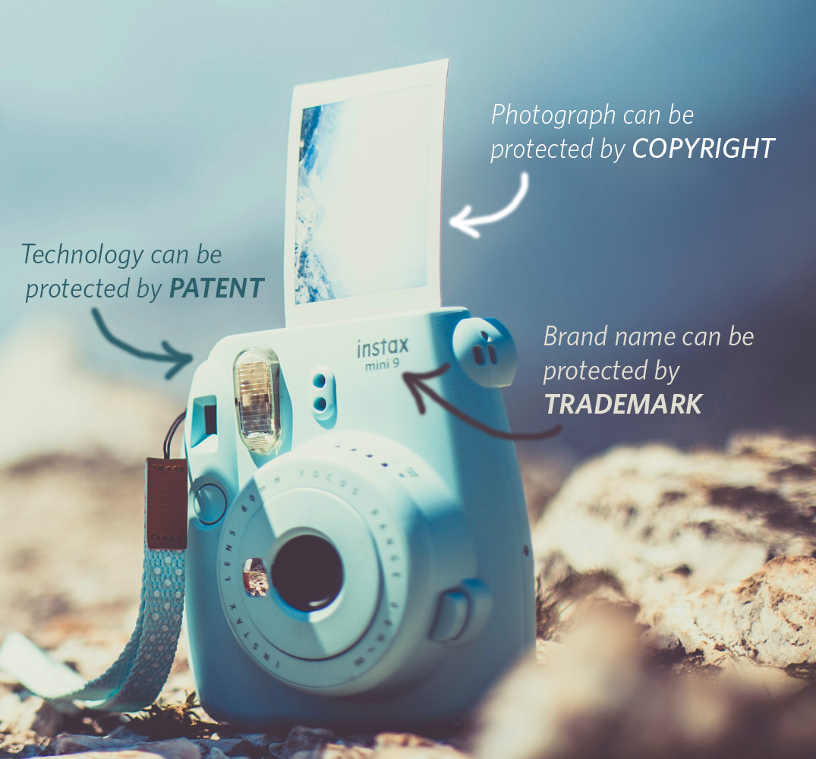
Types of IP
Patents
Trademarks
Copyright
Trade Secrets
Notes:
The first three types of IP are all able to be federally registered and protected, and these three types are the ones we will be discussing today. We will provide a brief explanation of each type of IP, explain how they are commonly used in social media, and discuss best practice for successfully using them.
Trade secrets are legally enforceable but are not registered federally – if you have a trade secret, you should not put it on social media.

Slide 5
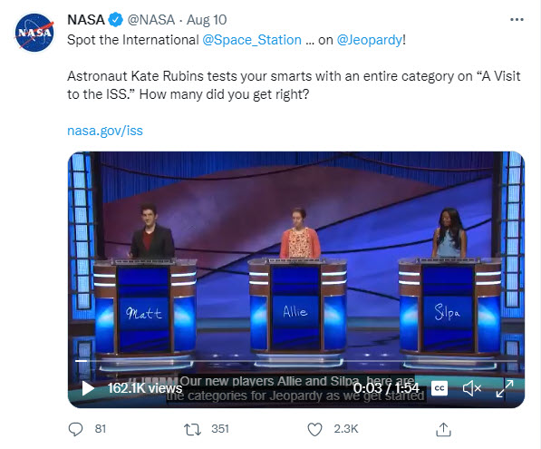
Why should I use IP in social media?
You probably already are – IP is everywhere!
Learning a bit about IP can help you use it deliberately
Notes:
How many of us have posted about our organization’s appearances on Jeopardy? In this example, the ISS itself contains patented technology, the name “Jeopardy!” is a registered trademark, and the Jeopardy! theme song has copyright protection
Chances are, you have already engaged with IP on social media – and that’s okay! Knowing the rules of the road can help you engage with protected intellectual property deliberately and avoid any potential pitfalls.

Slide 6
What is a patent?
A property right granted for technical inventions, mechanical processes, or designs that are new, unique, and usable in some type of industry.
Notes:
When issuing a patent, the USPTO does not judge whether an invention is commercially viable, only if it is novel and non-obvious.
Patent protection does not guarantee a technology will be brought to market, it only prevents others from doing so.
Fosters competitiveness – other companies and inventors can’t copy a patented technology, they have to improve on it somehow

Slide 7
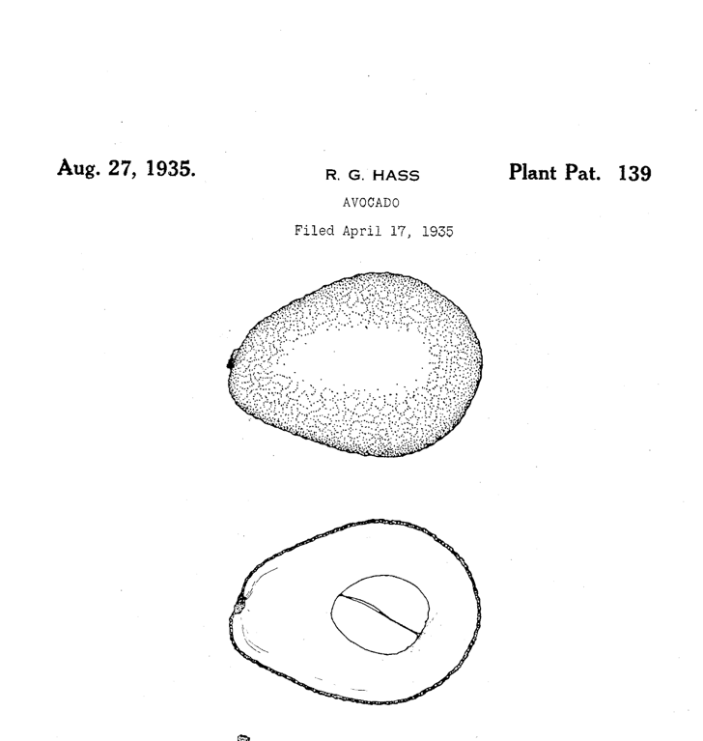
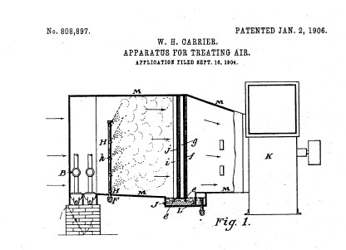
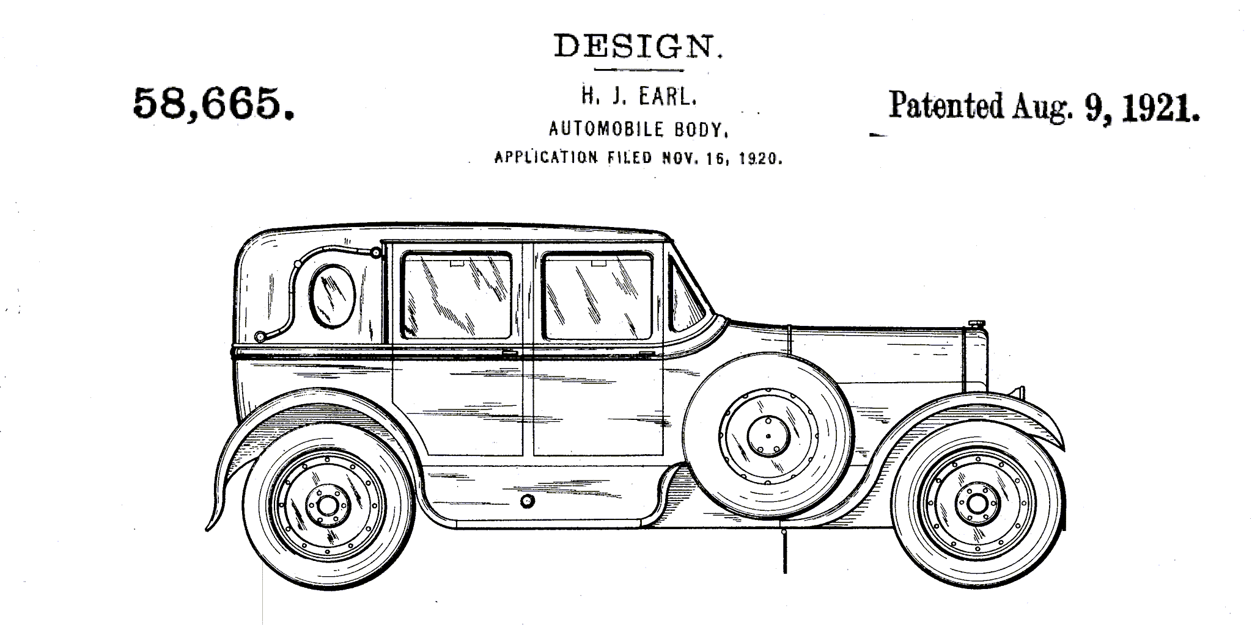
Different types of patents
Utility Design Plant
Notes:
Utility patents protect discoveries of new technologies or processes, or an improvement on existing ones. These are the majority of patents.
Design patents protect the ornamental design of an article of manufacture
Plant patents protect new varieties of plants

Slide 8
Patents on social media?
Patents are public domain
Patent art looks cool
Patents expire, so it is easy to avoid concerns about endorsement
Choose a patent more than 20 years old
Notes:
Car patent example

Slide 9
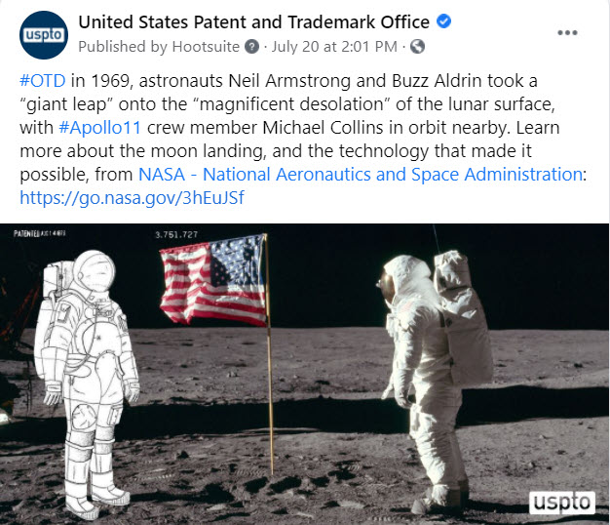
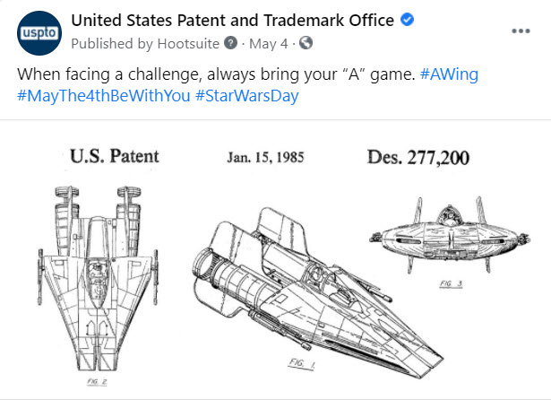
Examples

Slide 10
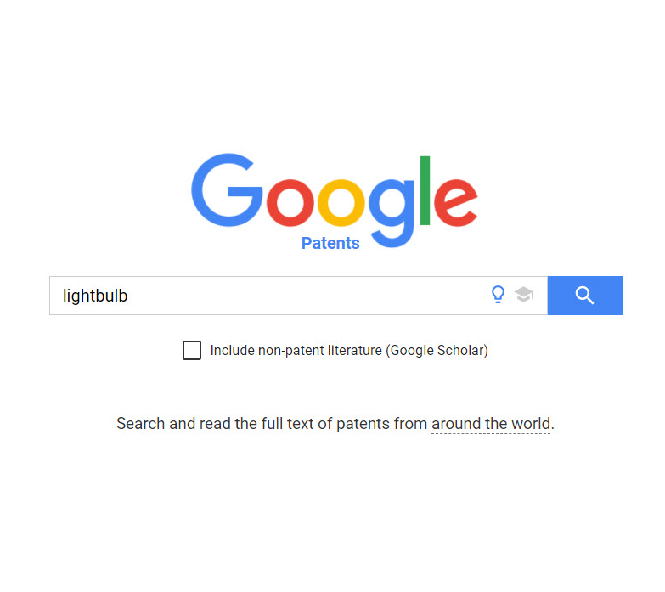
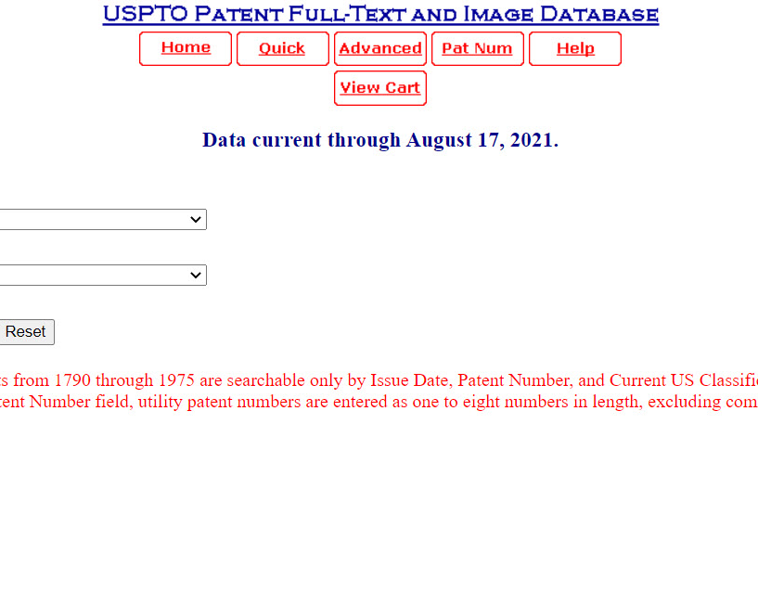
How to find patents

Slide 11
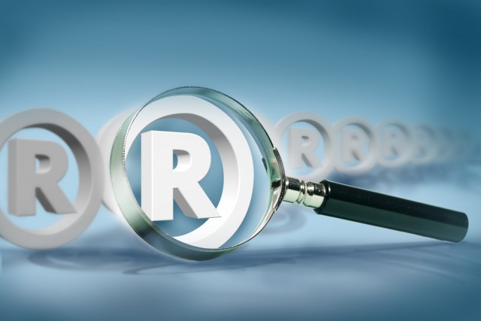
What is a trademark?
A trademark protects any word, slogan, symbol, design, or combination of, that identifies goods or services, indicates their source, and distinguishes them from the goods or services of others.

Slide 12
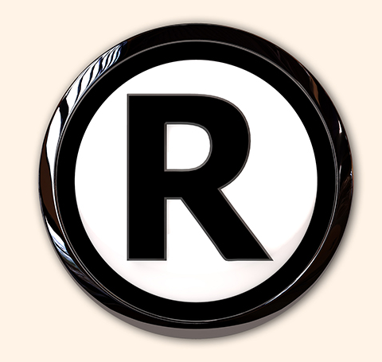
Why register a trademark?
Protects your brand from misuse and imitation
Prevents your trademark from being registered by others without your permission
Notes:
You do not need to apply for federal registration to claim a trademark, but registration provides many benefits, including having your trademark nationally protected instead of regionally and being able to bring legal action concerning your trademark to a federal court, and

Slide 13
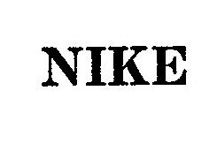
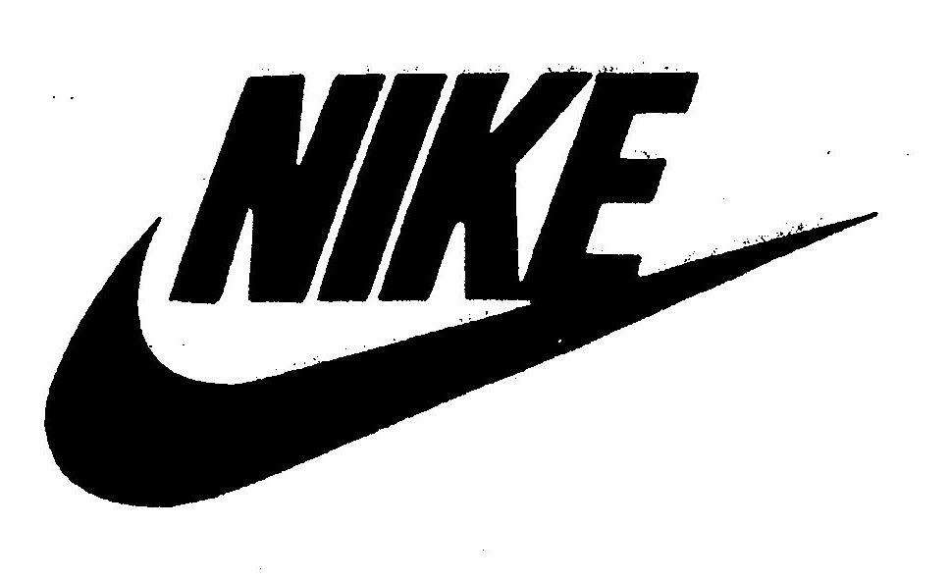
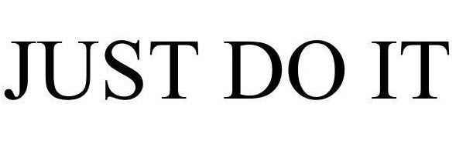
Different types of trademarks
Notes:
Many registered trademarks are company or brand names, logos, or phrases used for marketing

Slide 14
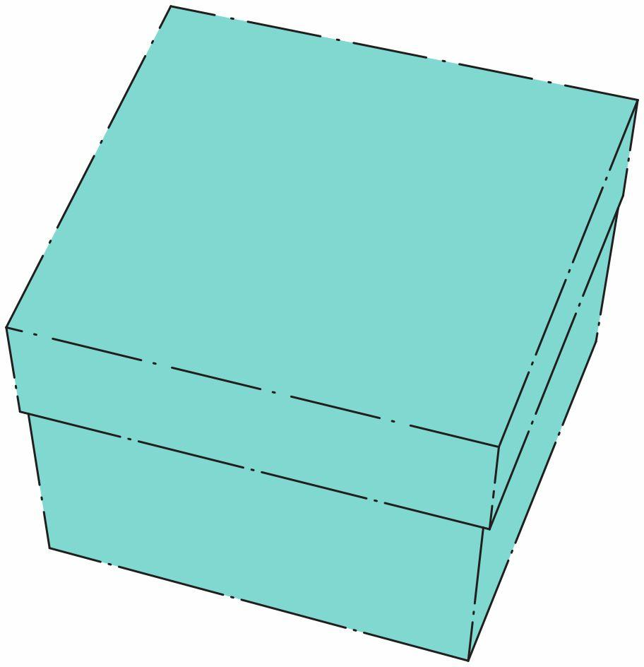
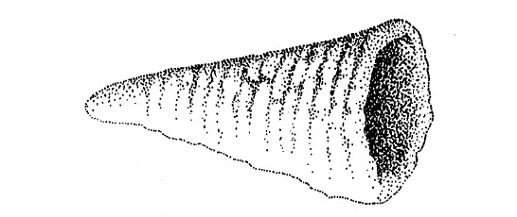
Different types of trademarks
Notes:
You can also register a trademark for things like shapes, colors, and even sounds
General mills = shape of bugle
Tiffany = tiffany blue
Sounds and smells – hasboro has a trademark for the smell of play-dough, NBC has a soundmark for the three-note NBC chimes

Slide 15
It’s a trademark, what do I do?
Trademarks offer protection in specific contexts
When in doubt:
Look up terms of service
Check with your legal team
Notes:
Trademarks offer protection in specific contexts, but do not give companies or individuals exclusive rights to a word or phrase. For example, Apple has a registered trademark for their brand, but that does not mean you cannot use the word “apple.” You just can’t name your tech company apple. Similarly, you can use the phrase “Super Bowl,” but you can’t name a sporting event the Super Bowl.

Slide 16
Trademarks and social media
Considering using a registered trademark as part of your social media content? Consider the following:
Does your post add value?
Does it support your mission?
Have you considered any negative consequences?

Slide 17
Endorsement?
Avoid appearances of endorsing a specific company or product
Highlight multiple trademarks when possible
Consider diversity in geography, size of company, and type of product
Check parent companies and research any potential scandals
Notes:
As the federal government, our voice carries weight, and we should try to avoid appearances of endorsement.

Slide 18
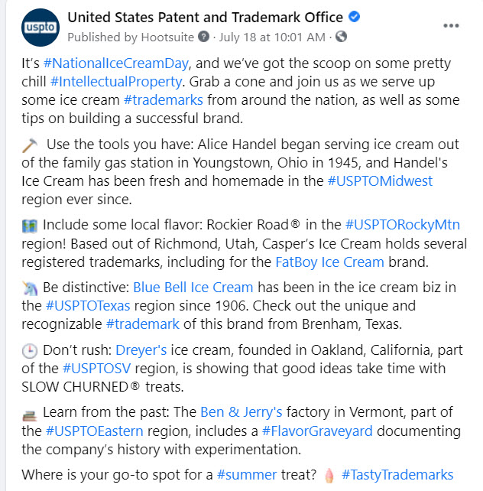
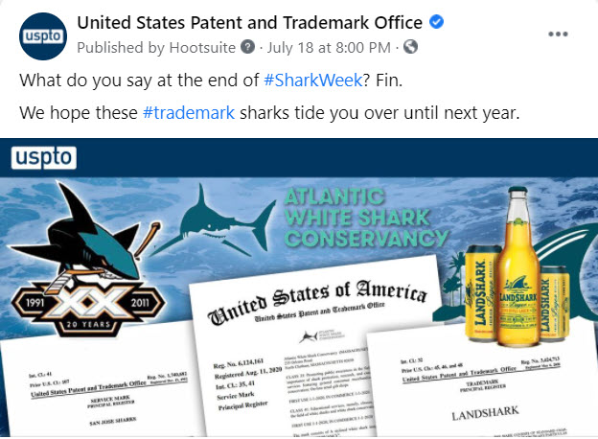
Examples

Slide 19
Education vs. promotion
You also want to avoid the appearance of using a registered trademark to promote your own services
This is mainly a concern with very well-known trademarks and trending topics
Ensure the main goal of your content is education

Slide 20
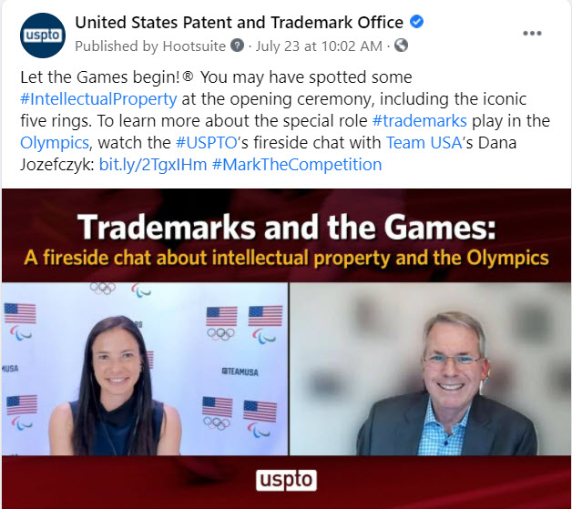
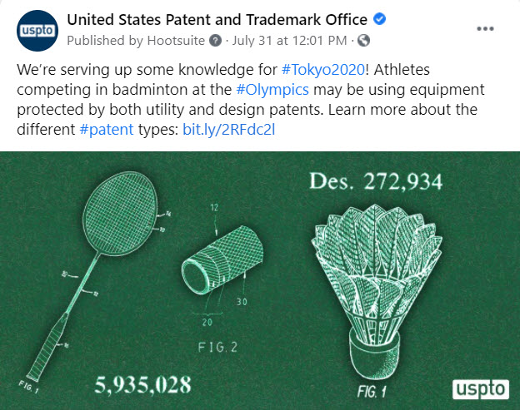
Examples

Slide 21
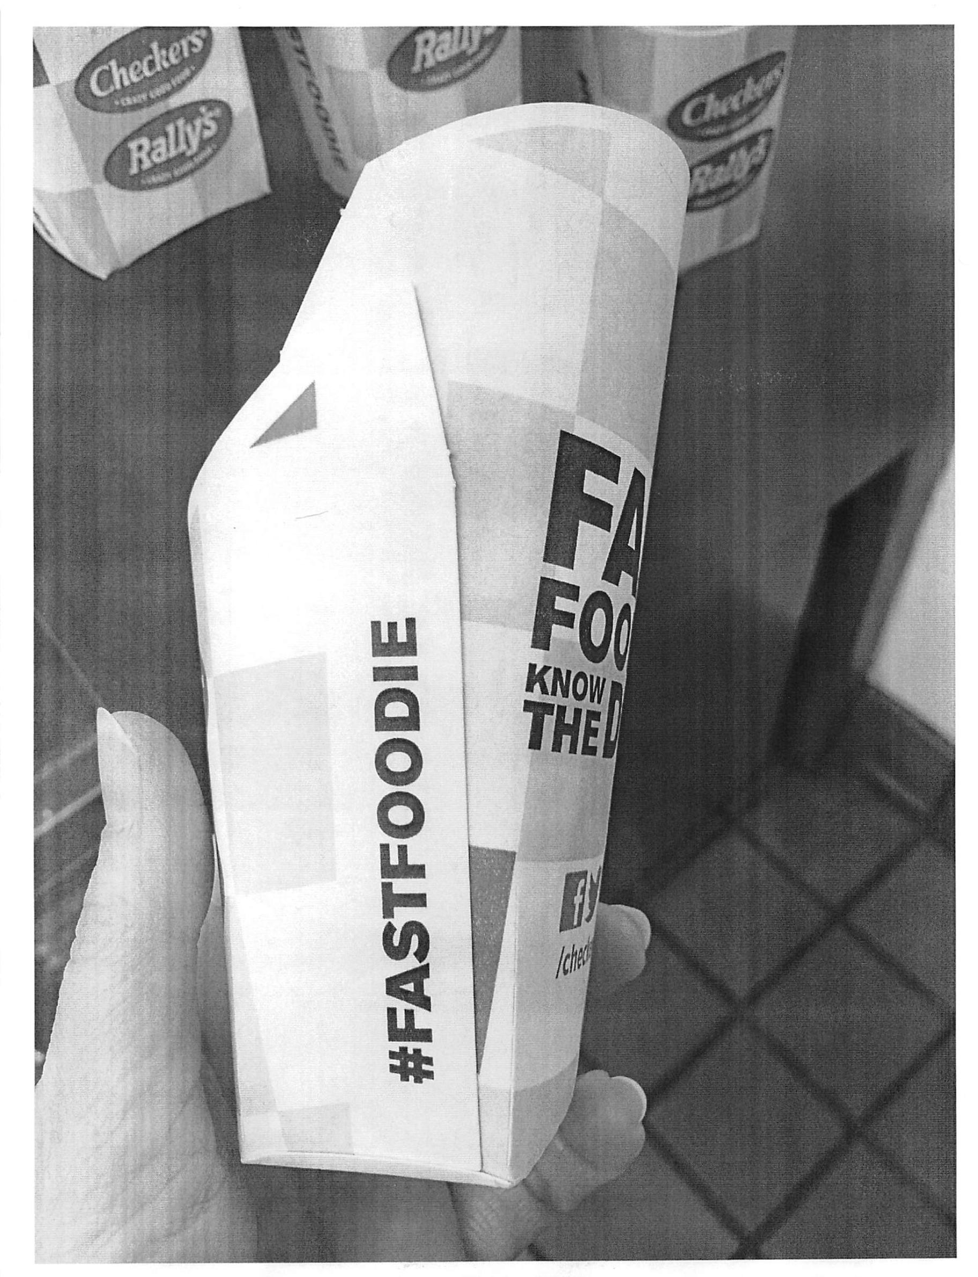
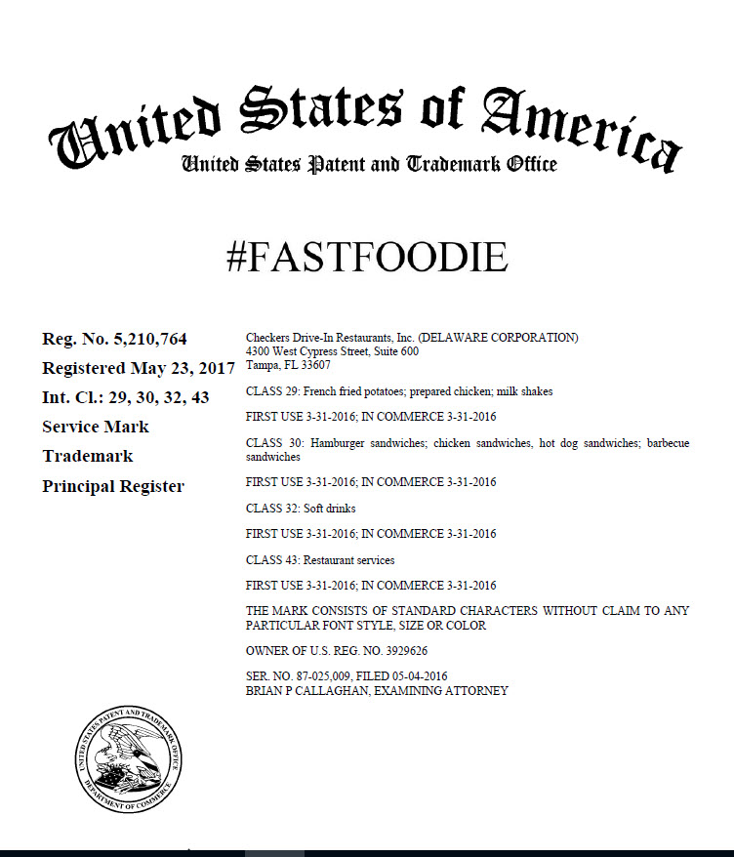
A hashtag as a trademark?
Only if you are using it as a trademark in commerce
Notes:
Can you register a hashtag as a trademark?
The answer used to be no, and in most cases it still is. If you are only using a hashtag as a way to search for your brand or company on social media, it is not eligible for trademark registration. For example, I frequently use the #USPTONearYou when posting content about our regional offices, but the USPTO could not register this as a trademark because we do not use the tag anywhere besides social media.
However, if a company uses its hashtag as a trademark, it is registerable. In this example, Checkers has registered the #FastFoodie, which they are using as a trademark on their products.

Slide 22
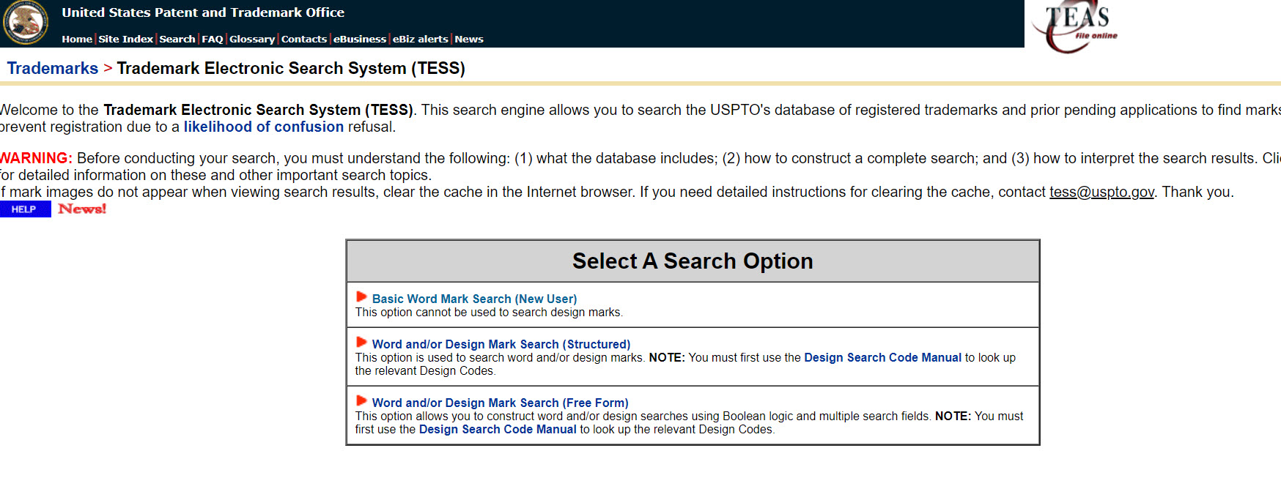
How to search for trademarks

Slide 23
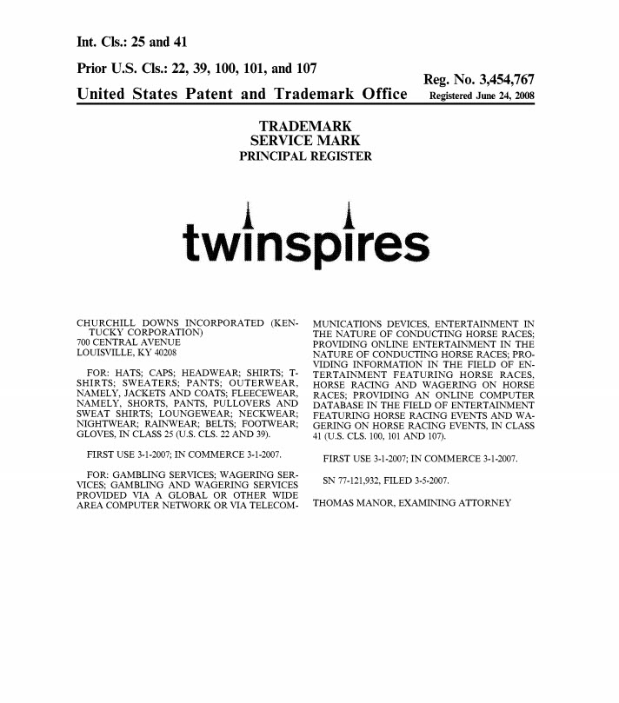
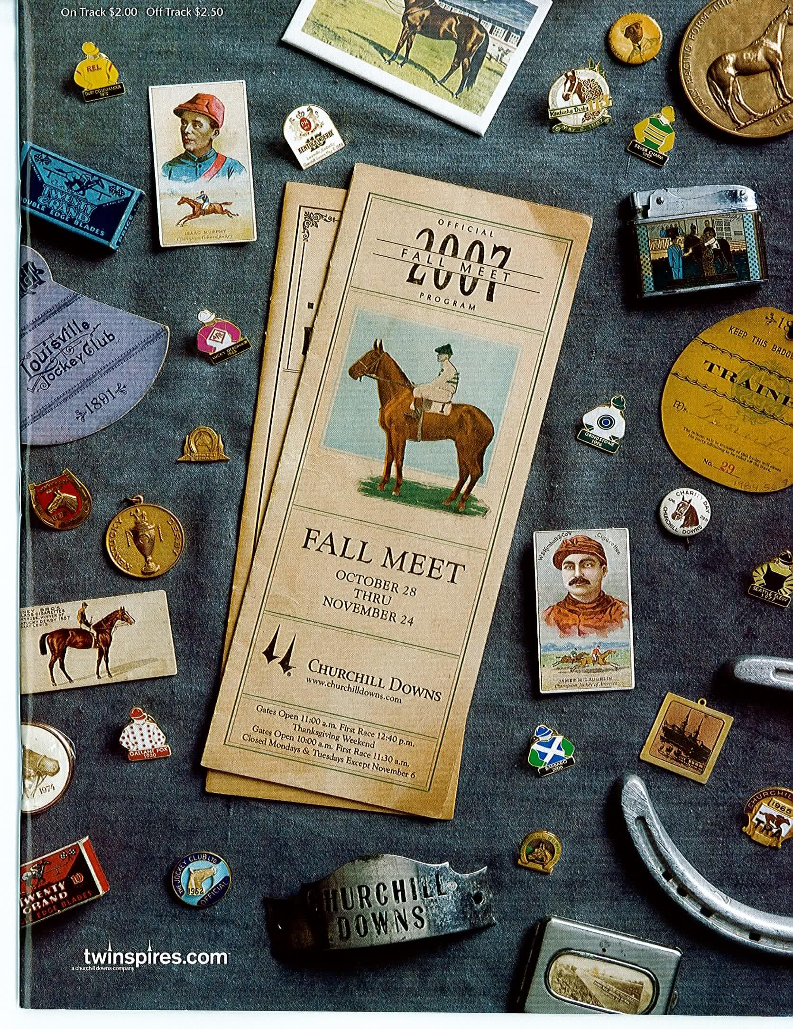
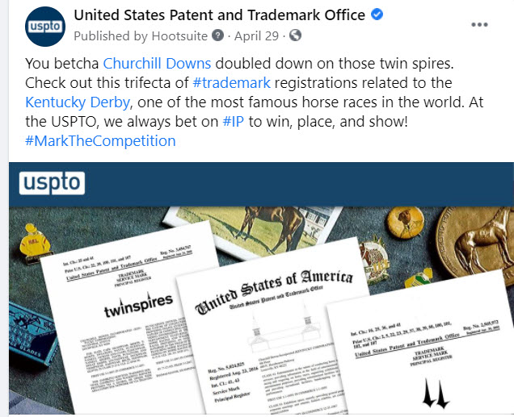
Trademark registrations and specimens – all in the public domain!

Slide 24
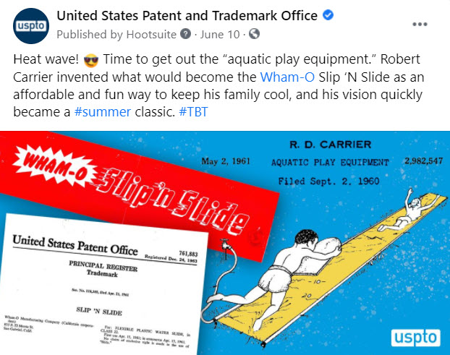
In conclusion
Don’t be afraid of using patents and trademarks in your social media campaigns, just be savvy about how you use them
IP can provide some great resources in the public domain for strategic use on social media

Slide 25
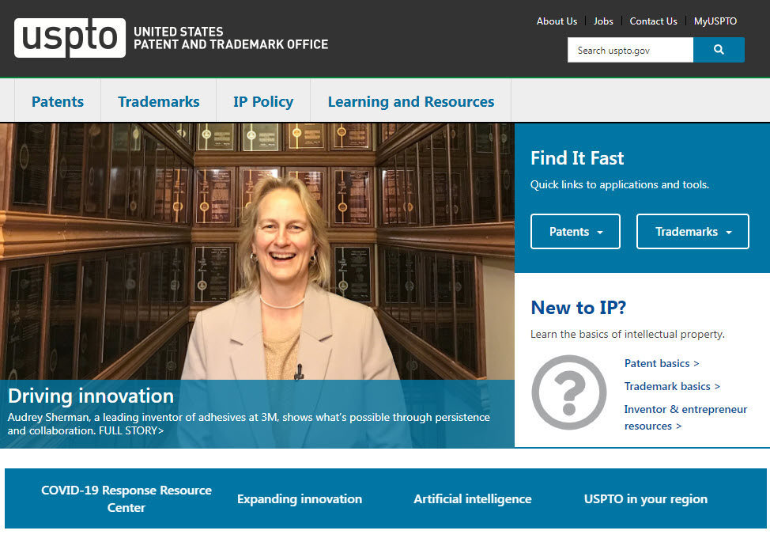
Resources
USPTO homepage: www.USPTO.gov

Slide 26
United States Patent and Trademark Office (USPTO)

